Slide 1



Facial Recognition Attendance System
Group: 3
Presentation: Yinqiao Li
Notes:
Good afternoon, everyone. My name is Yinqiao Li. I'm delighted to welcome you to our team's Final report.

Slide 2


Content
Project Introduction
Module Introduction
Complement
Demo
Notes:
In the next few minutes, I'll walk you through the core components of our project, including a brief on what we've been working on, the different modules and the complement part for development.
By the end of this presentation, I hope to provide you a clear picture of our project and a comprehensive understanding of the delicate design we have been putting in.

Slide 3
Project Introduction
What is our Project?

Slide 4
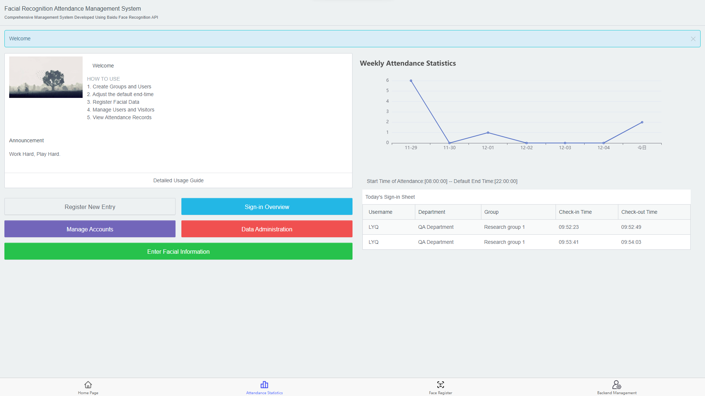
Notes:
Our Facial Recognition Attendance System Project is a comprehensive solution designed to help attendance management. Including attendance management based on Face ID and the innovation of statistics automatic pushing on WeChat.

Slide 5
Project Introduction
How do we develop our project?

Slide 6



Project Introduction: Individual Job Distribution
PM
Guanhuan Du
Test&PRE
Yinqiao Li
Front&Modules
Shizong Pang
Modules
Jiuyin Shen
Notes:
We’ve divided the tasks among our team members, focusing on their strengths to maximize efficiency.And there is no difference from other groups.

Slide 7

Project Introduction: Individual Job Distribution
Report&Modules
Lin Huang
Report&Modules
Jialin Wei
Report
Tianyi Ding
Report
Hao Liu
Notes:
We’ve divided the tasks among our team members, focusing on their strengths to maximize efficiency.And there is no difference from other groups.

Slide 8
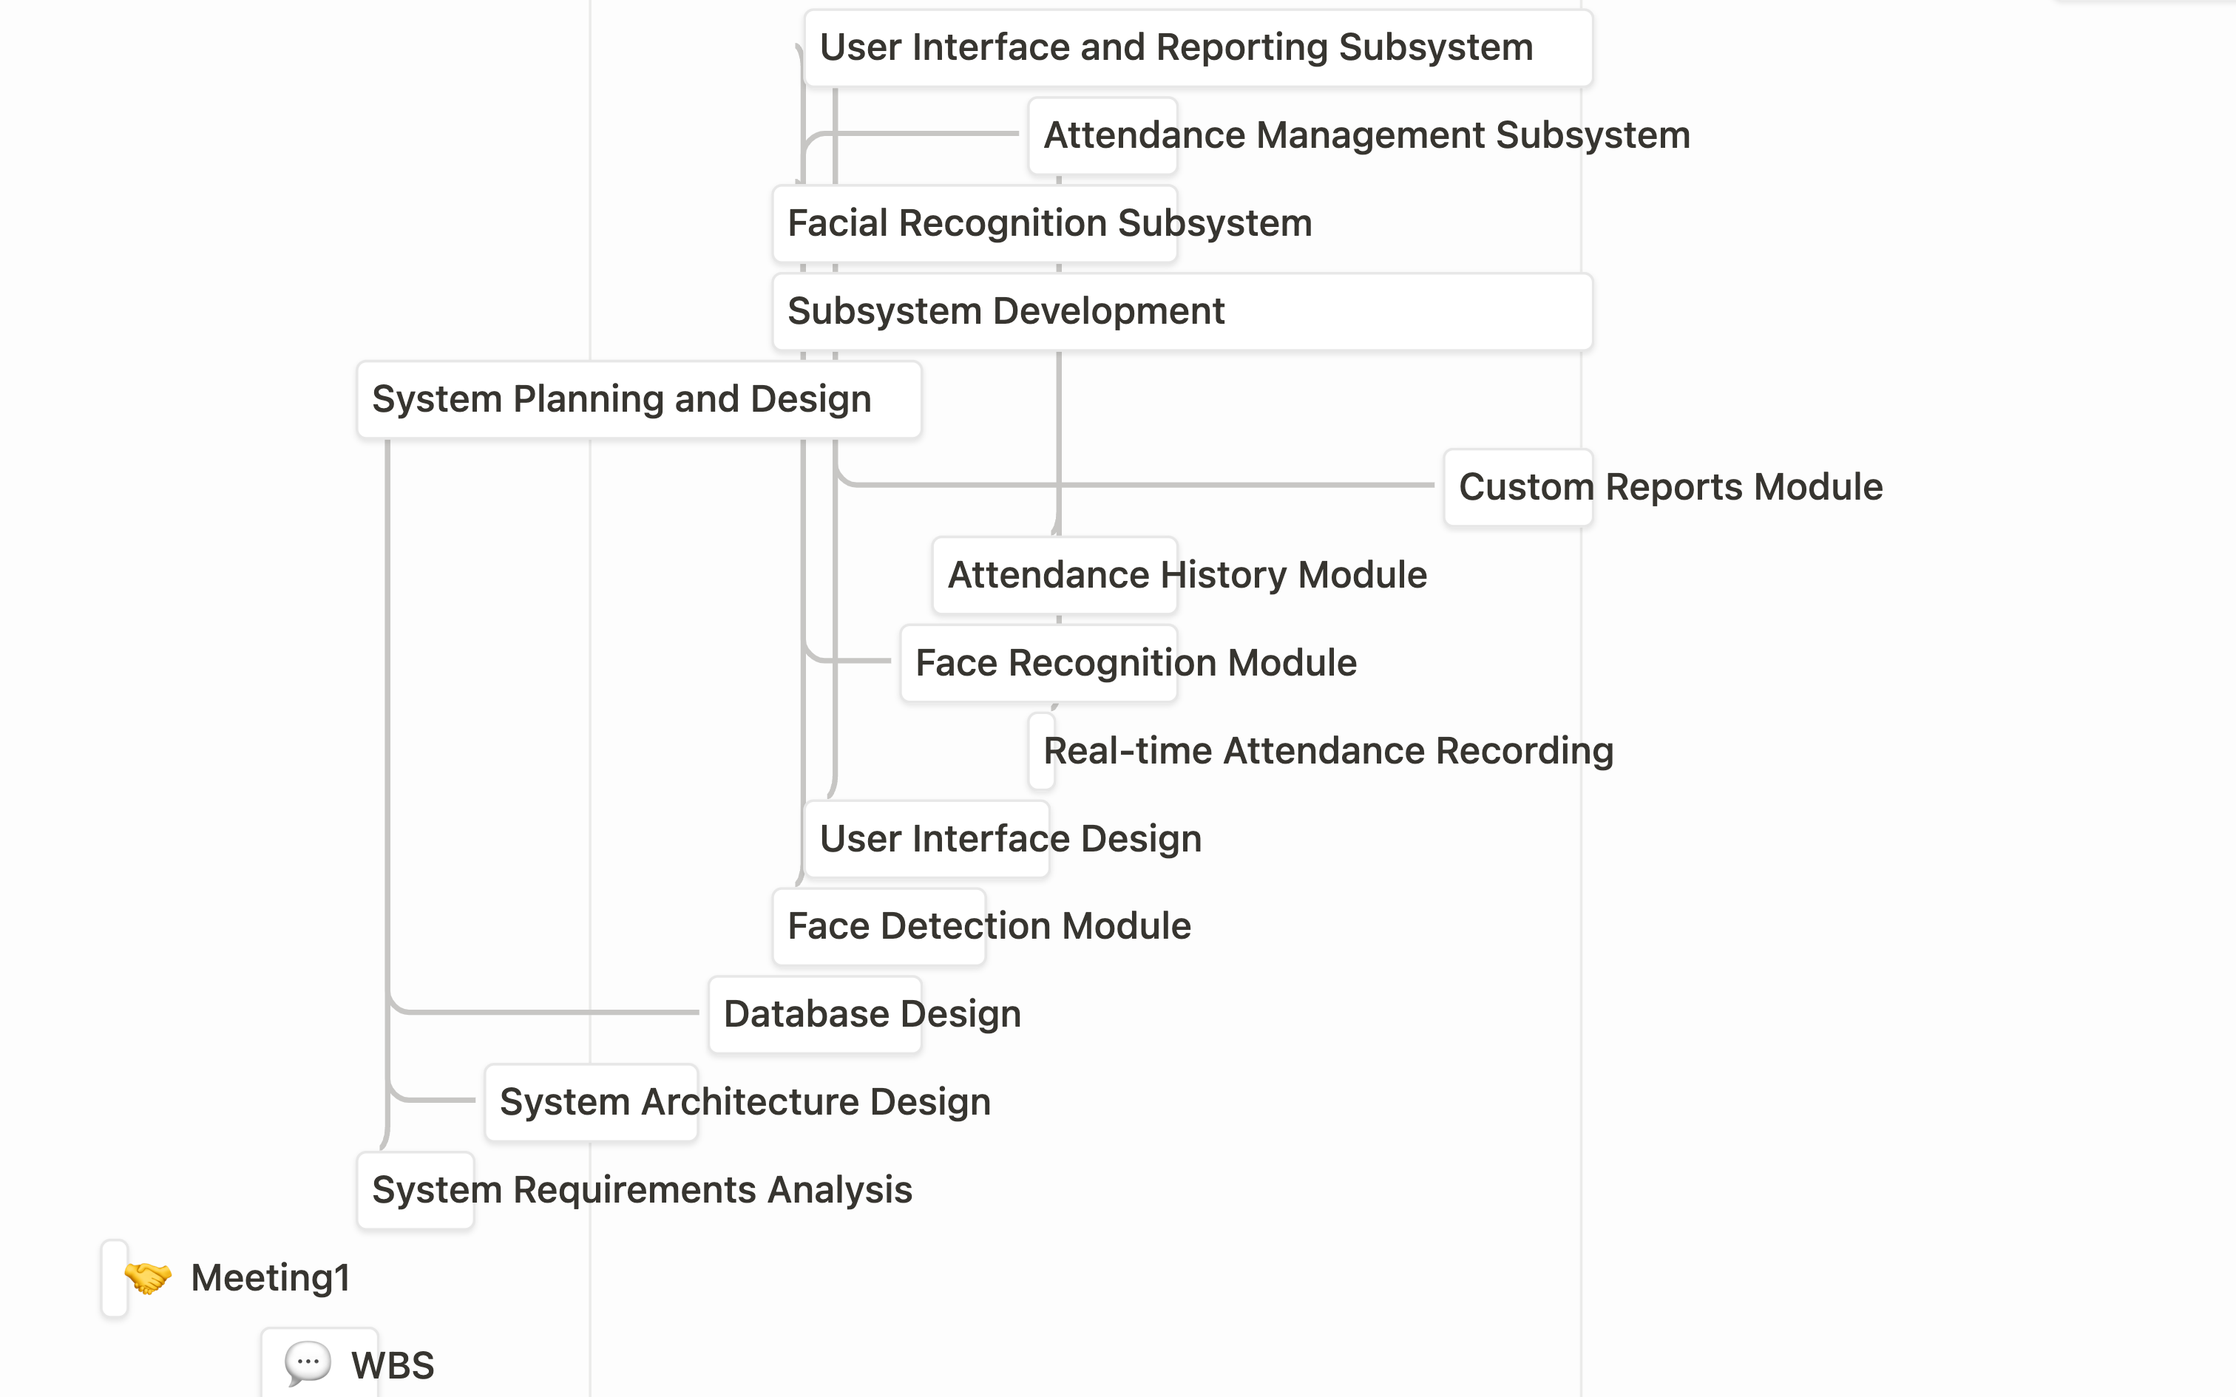
Notes:
In the first two months, we basically complete the main modules development.

Slide 9
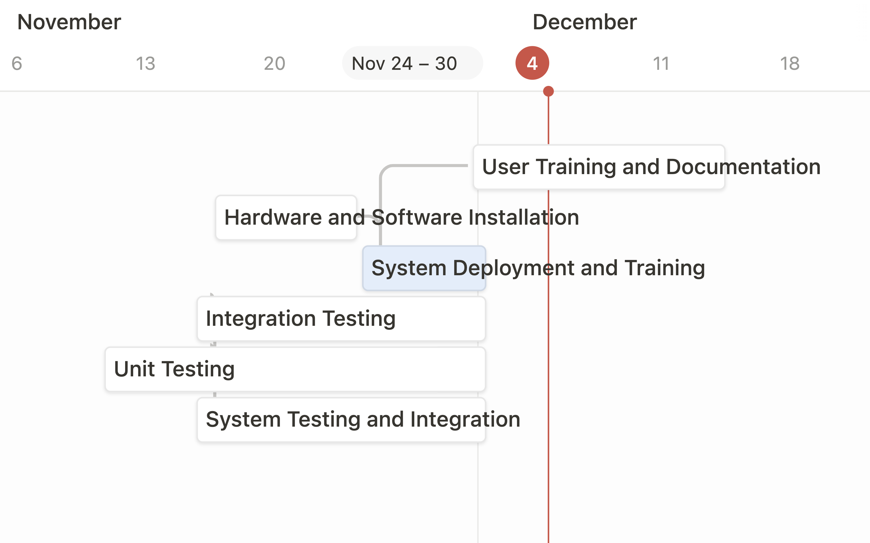
Notes:
In the following weeks after mid term report, we finished the translation work of front view and the complement of notification pushing module.

Slide 10
Module Introduction
What modules does it have?

Slide 11


Module Introduction
Face Recognition & Detection
Attendance Recording
User Management
Notification
Fingerprint Recognition
Notes:
Our system features modules for Face Recognition, Attendance Recording, and User Management. NFC and Fingerprint Recognition are in development and pending evaluation for integration.

Slide 12
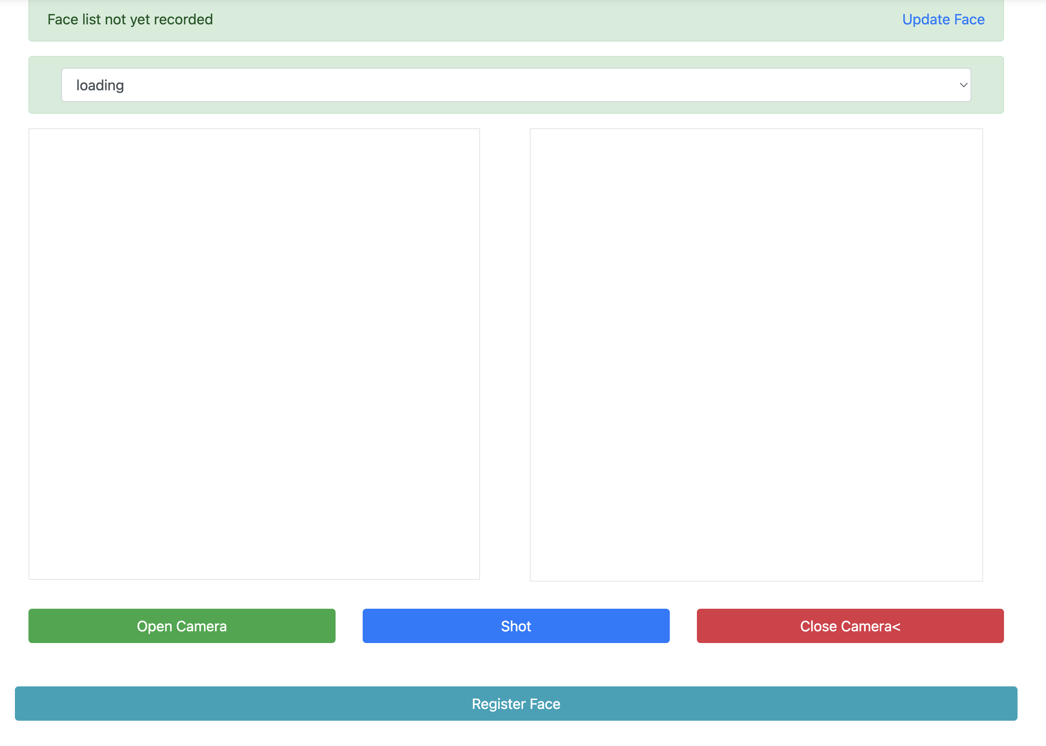
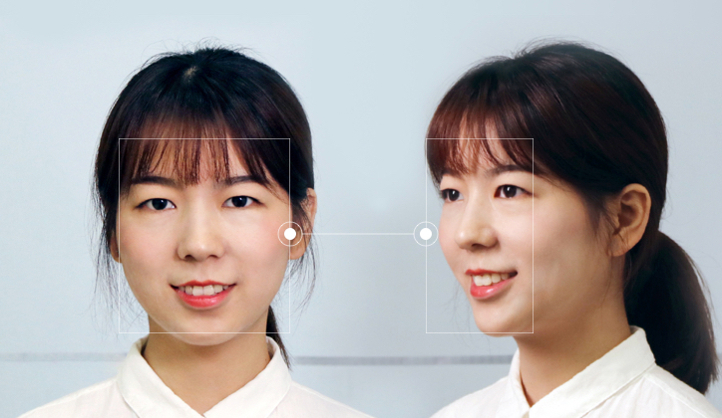
Module Introduction
Face Recognition
& Detection Module
BaiDu Identity Verification
Notes:
We’ve introduced the Face ID module last month, Bur it remained privacy issues.

Slide 13
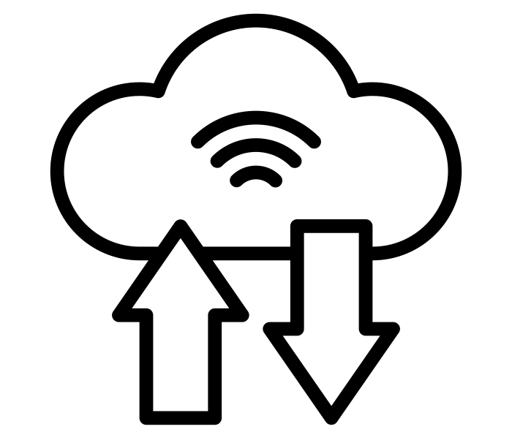
Privacy Issues
Face Recognition
& Detection Module
Data on Cloud
Verification Process on Cloud
Notes:
And we reconsider the privacy issue and decide to manage and store the data on Cloud. Only the admin account can have access, thus the privacy data will not leak in the local network.

Slide 14
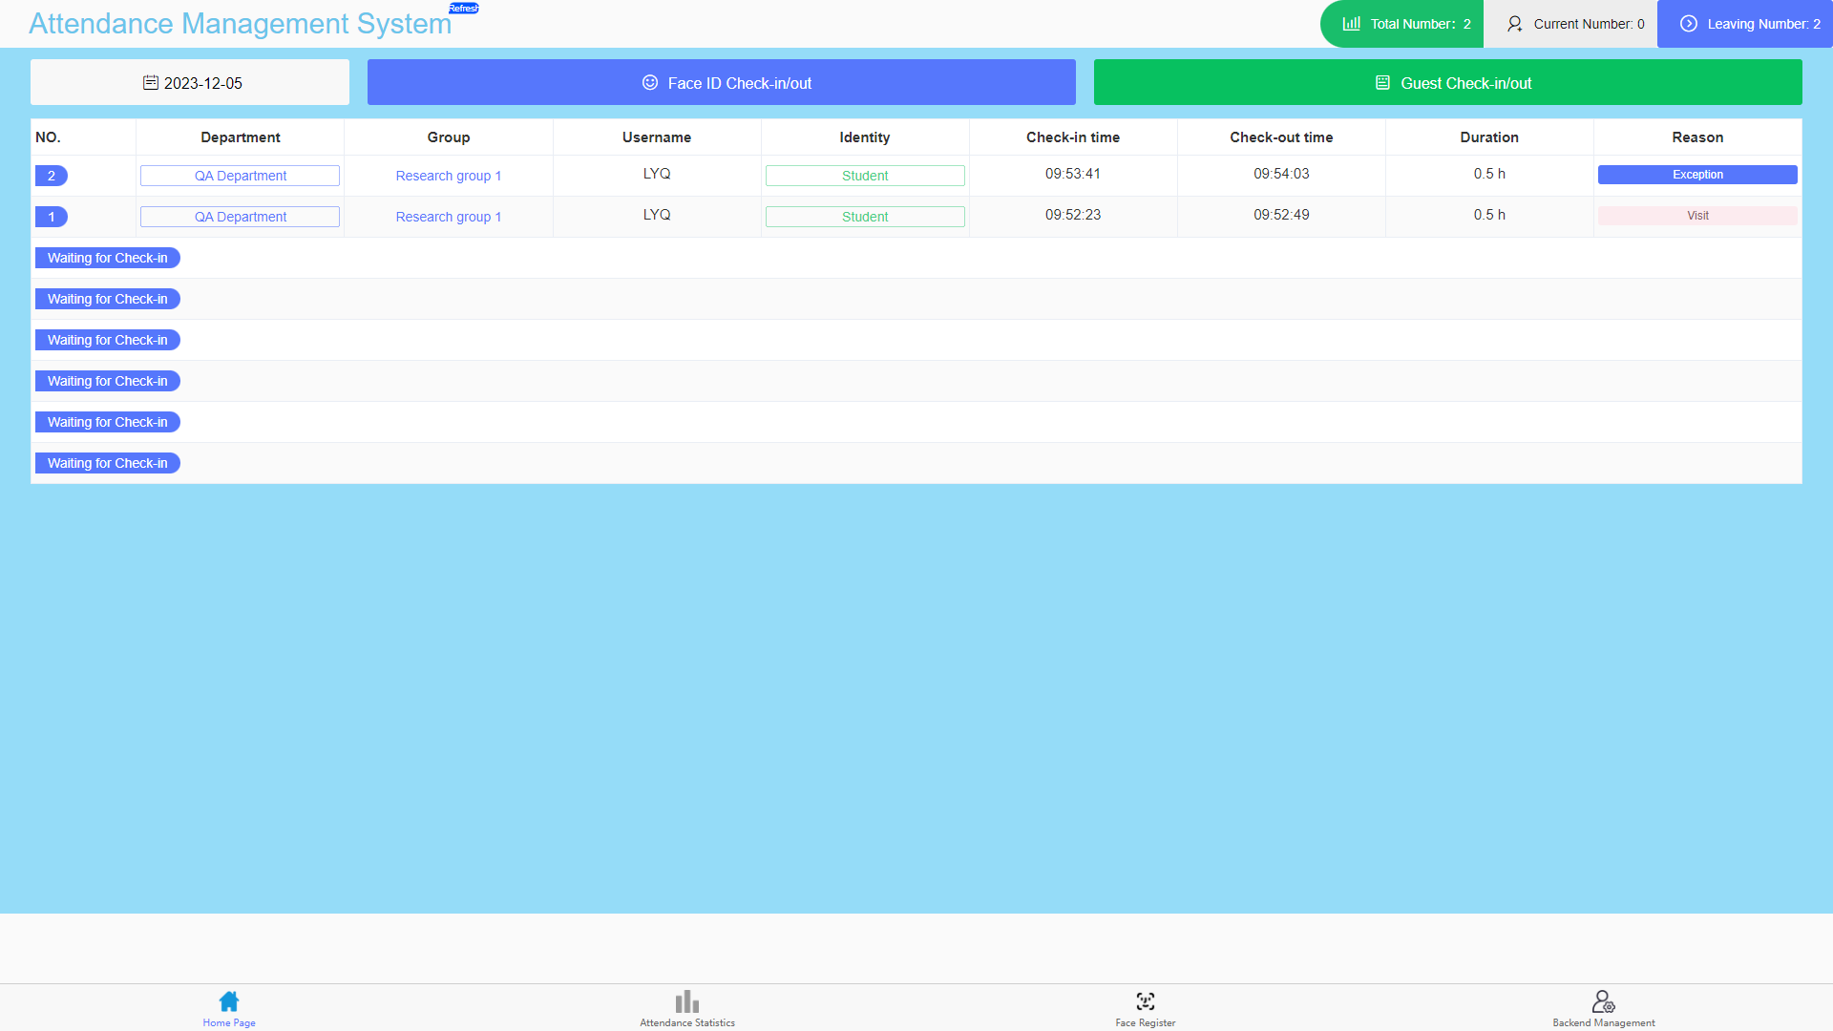
Module Introduction: Attendance Recording Module
Notes:
Turning on to the attendance management module, here we can track attendance status, with clear indicators for arrivals, departures, and exceptions.

Slide 15
Complement
Complement

Slide 16
Complement
Fingerprint Recognition
Notification
Notes:
We mentioned fingerprint and notification pushing on WeChat, this two modules in mid-term.

Slide 17
Complement：Concision
Fingerprint Recognition
Notification ✅
Notes:
We mentioned fingerprint and notification pushing on WeChat, this two modules in mid-term.

Slide 18

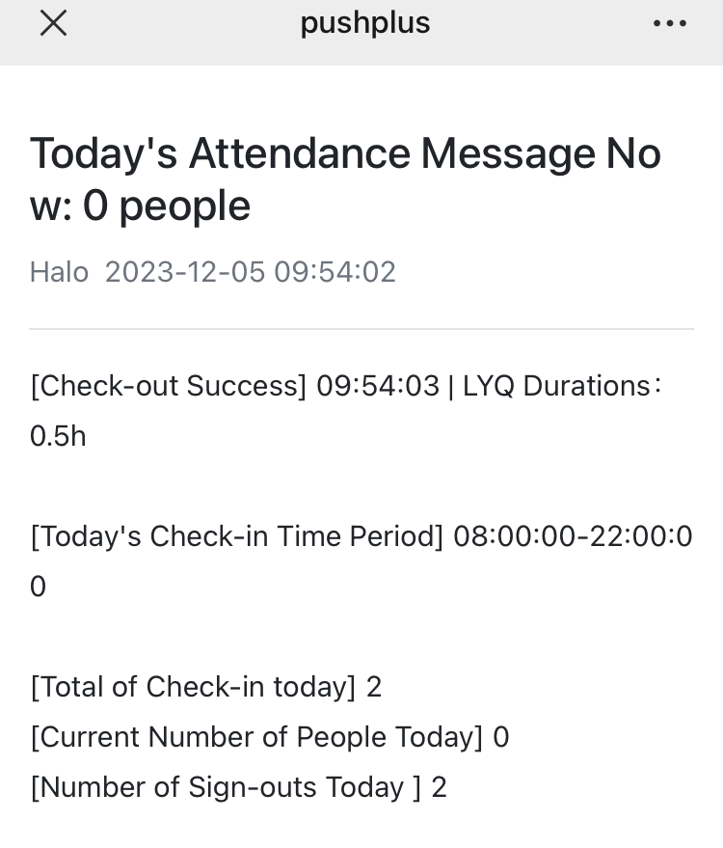
Complement：Innovation
Notification Pushing
on WeChat
Notes:
The decision whether to embed the fingerprint recognition feature was made after reassessment. We decided to concise this module given the fact that we already have a facial recognition module.
And we successfully integrate the message pushing module on Wechat, enabling users to view the lasted statistics smooth and flat.

Slide 19
Thanks

